Slide 1



Species Distribution Models for Eagle Use in the Continental United States
Grant #1851948
Eugene Monforte, Cal Poly Pomona
Annaliese Chen, Swarthmore College
Justine Fretz, Lafayette College
Mentored by: Dr. Leslie New, Ursinus College

Slide 2
Ursinus College respectfully acknowledges that our campus rests on Lenapehoking, the ancestral and spiritual homelands of the following five nations: Delaware Tribe of Indians, Delaware Nation, Eelunaapèewii Lahkèewiit (Delaware Nation at Moraviantown), Stockbridge-Munsee Community, and Munsee-Delaware Nation (Ontario). Our community carries names derived from the Lenape language--names holding spiritual and cultural meaning while also bearing the remembrance of the systematic removal of the Lenape people over 250 years ago by European colonial powers, whose legacy still reinforces and benefits from the Lenape's disenfranchisement. Ursinus College commits to collaboration, representation, and inclusion as we work together with the Lenape people to bring about healing and reconciliation between and among all our communities

Slide 3

Context
Bald and golden eagles collide with operating wind turbines
Violation of U.S. law
Unavoidable
Eagle Permit Rule
Predict take in advance
Bayesian collision risk model
Fatalities (F) are dependent on exposure (λ), hazardous space-time (ε) and collision probability (C)
Posterior on λ informed by data on eagle use
$$F= ελC$$

Slide 4
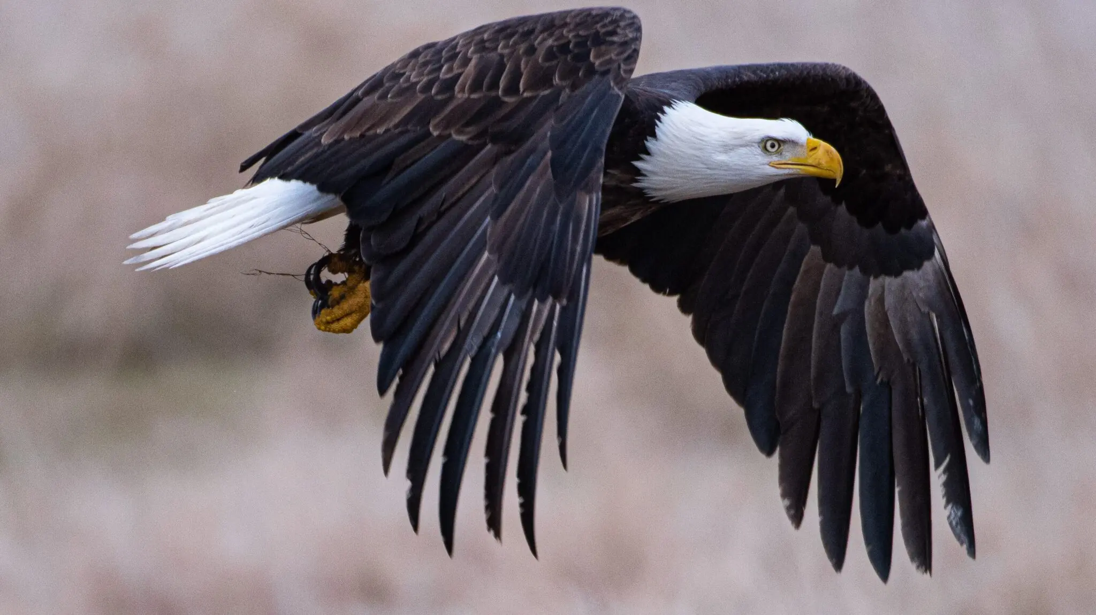
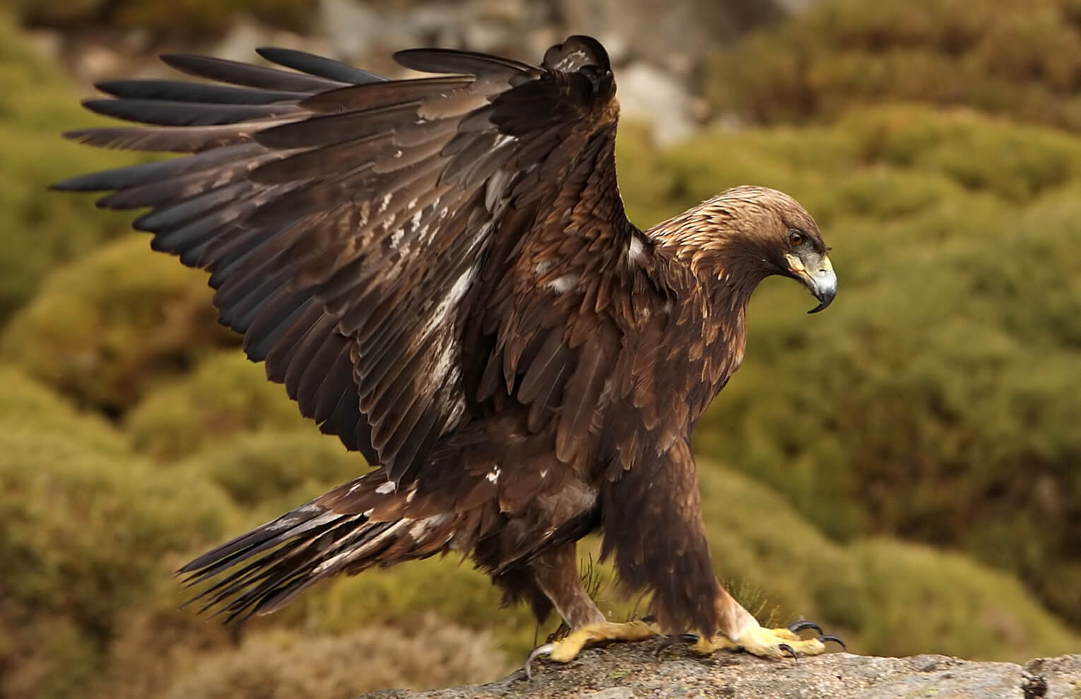
Problem and Potential Solution
Problems:
Facilities don’t want to collect data
Expense
Logistical difficulties
Data collected not sufficient for the purpose
Incomplete
Collected after turbines are operational
Potential Solutions
Avoid poor locations from the start
Target low use areas
Predict eagle use on the landscape
Source: BirdLife International
Source: American Bird Conservancy

Slide 5
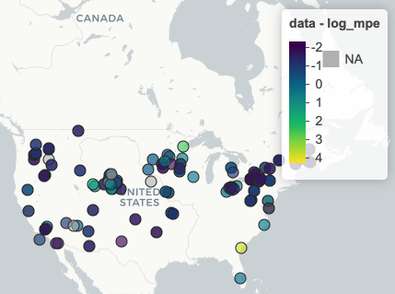
Data
119 wind facilities
100 bald eagle
97 golden eagle
eBird
Relative abundance
Geographical and Environmental Covariates¹
Land cover
Topography
Weather
Ecoregion
Log_mpe = log(eagle_minutes/effort)
¹Dunk et al. (2019) Modeling spatial variation in density of golden eagle nest sites in the western United States. PLoS One, 14(9): e0223143
Notes:
Geographic and environmental space, although not really accounting for geographic proximity. Most locations are not geographically close

Slide 6
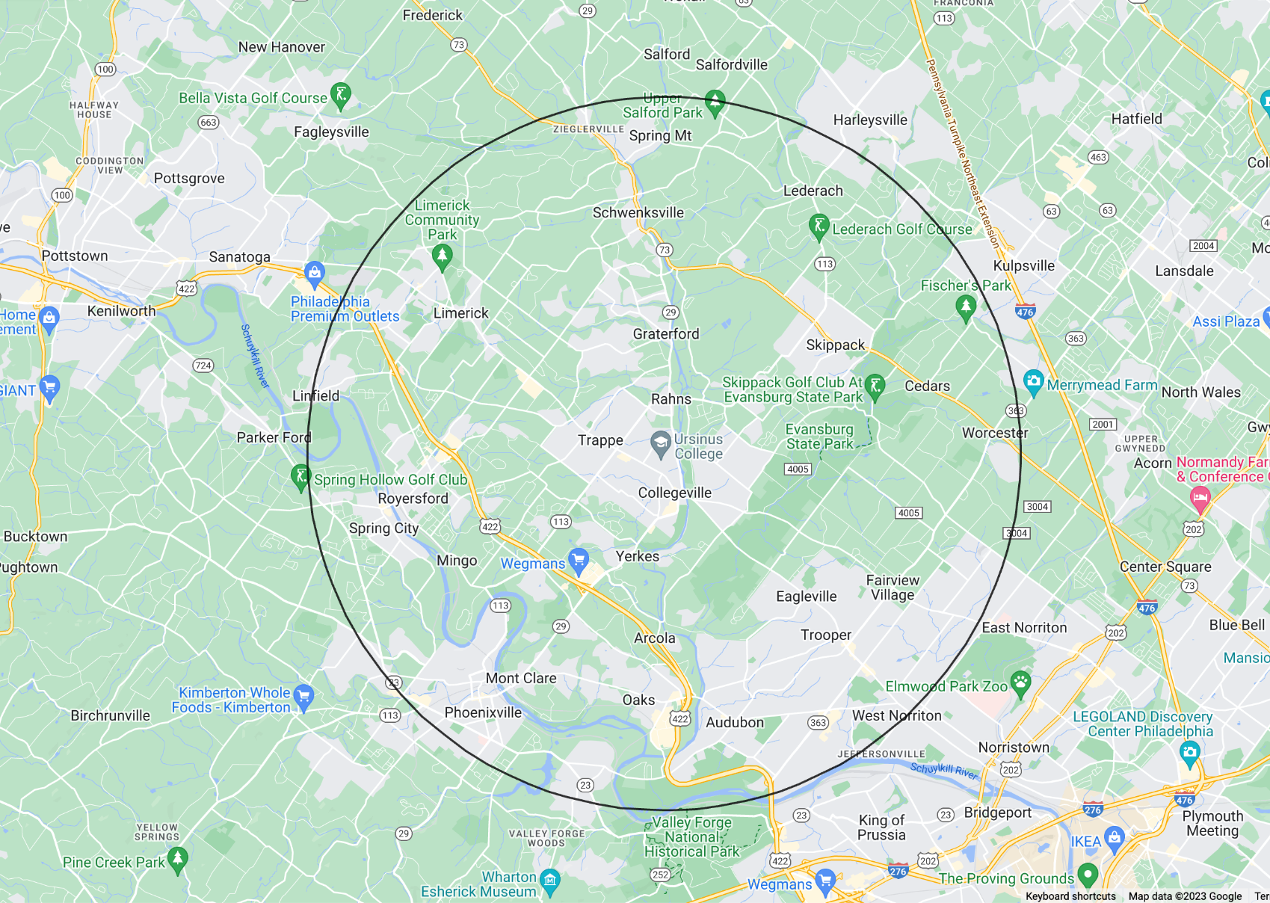
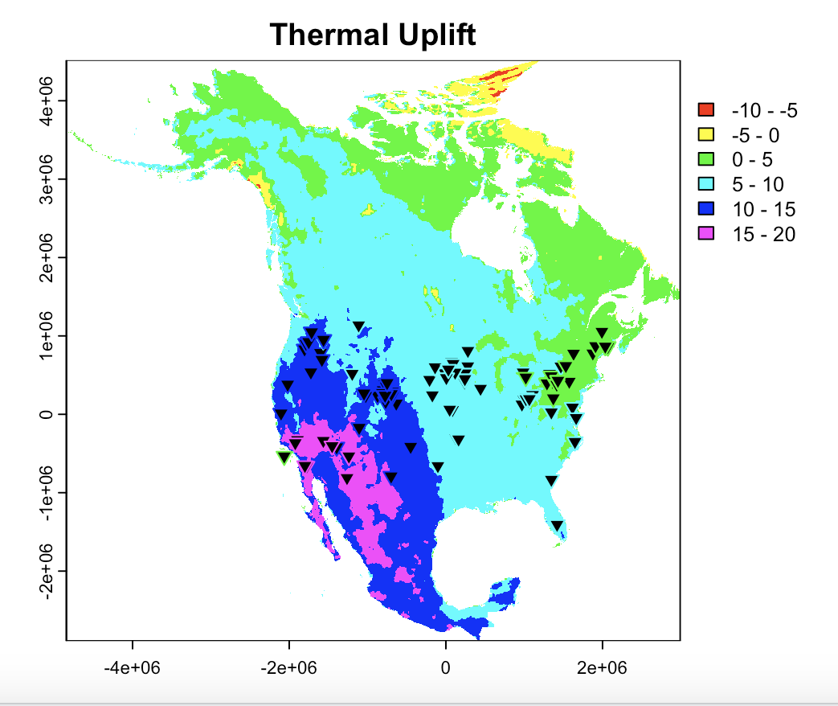
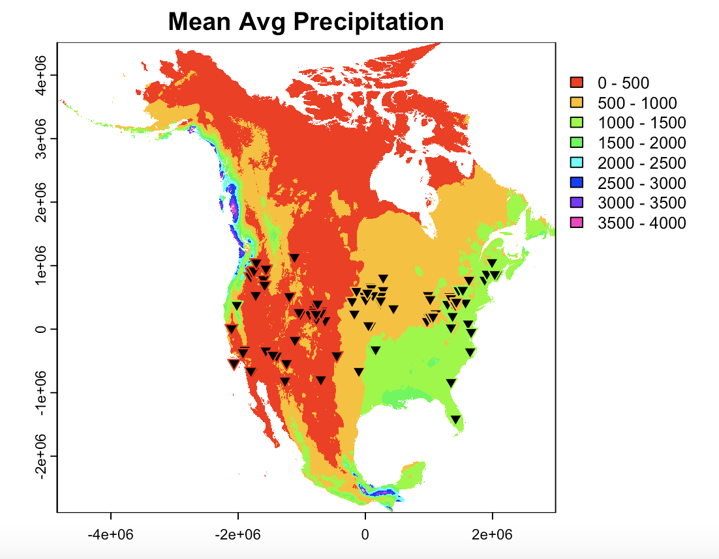
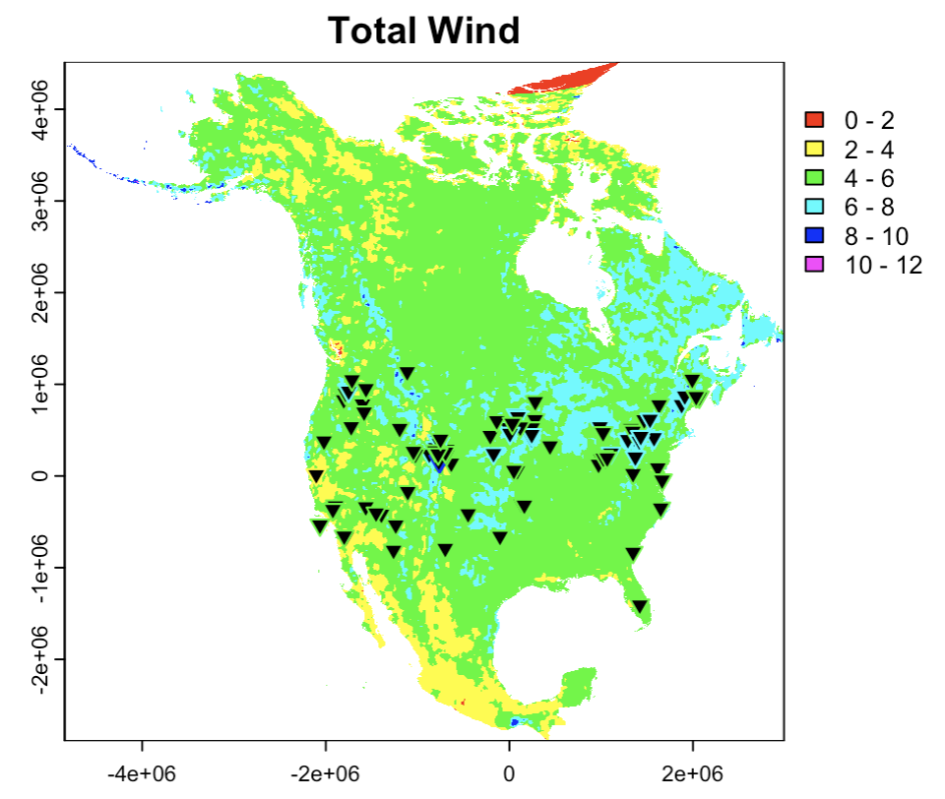
Weather and Topography
10 km radius around each wind facility
Average value within the radius
Notes:
Don’t know the scale at which eagles are responding to the landscape – may vary

Slide 7
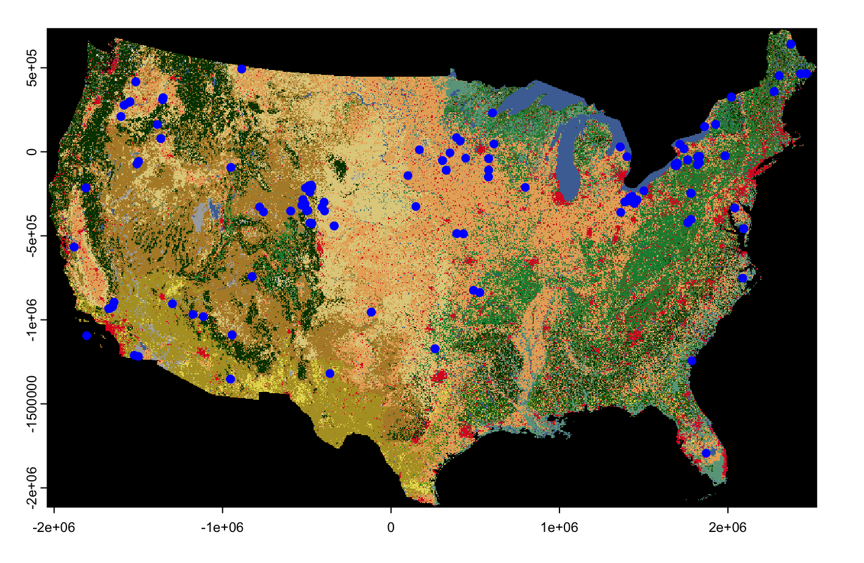
Land Cover
30m x 30m resolution
Convert to proportion of landcover type

Slide 8
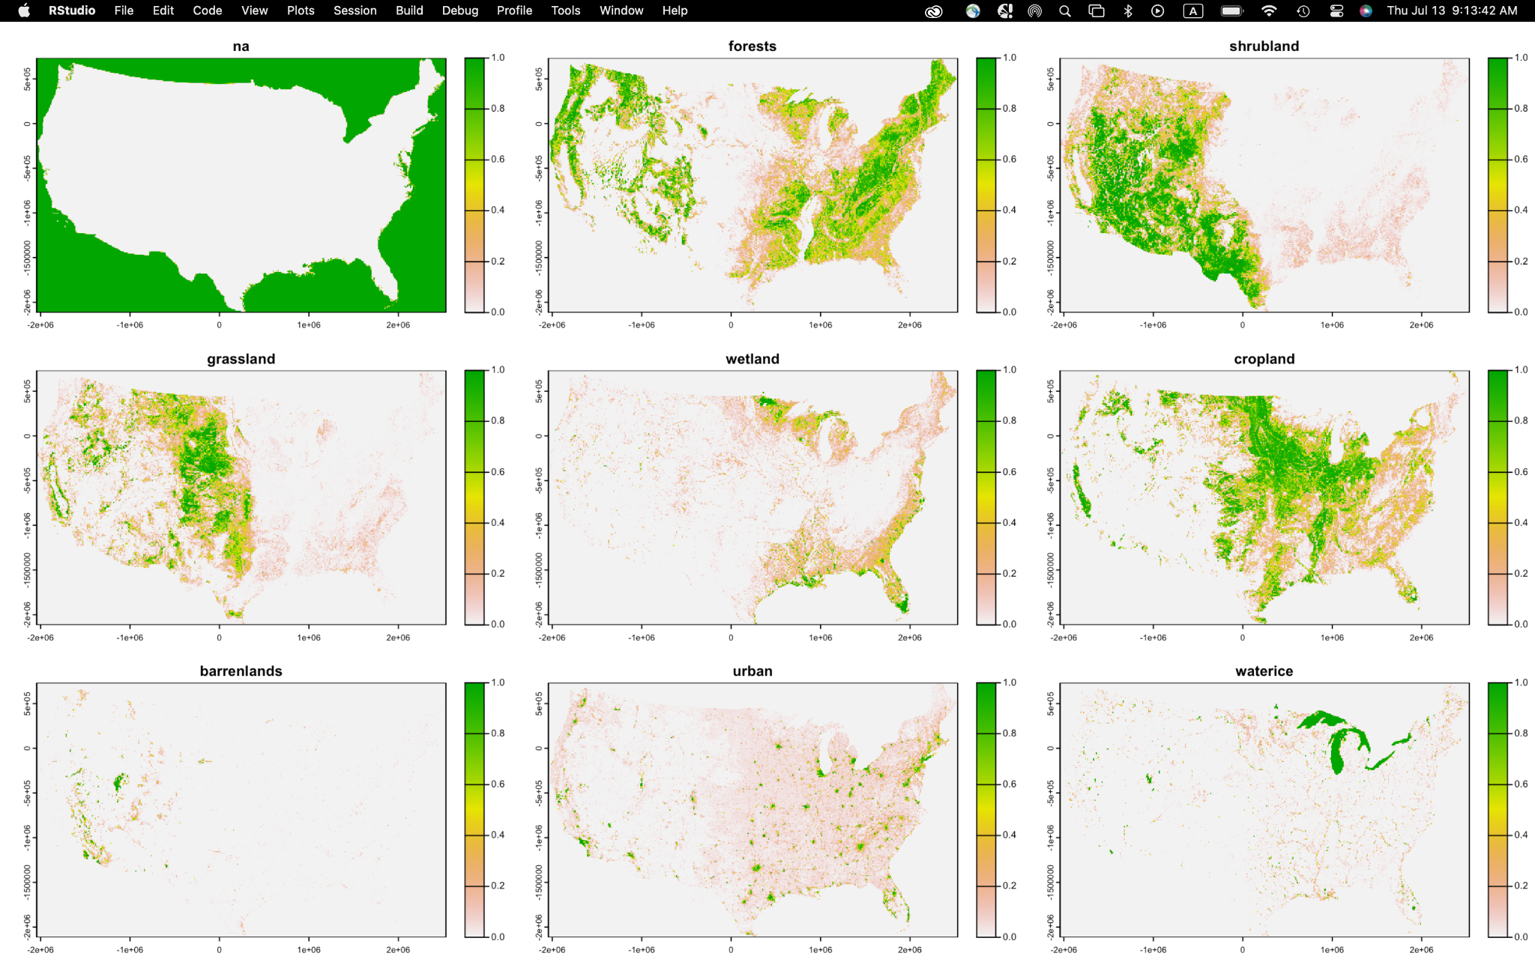
Land Cover

Slide 9


What’s In a Name?
Bald Eagles
Eagle min/
Effort Regression Model
Golden Eagles
Eagle min/
Effort Regression Model
Source: Beer Advocate
Source: Etsy

Slide 10
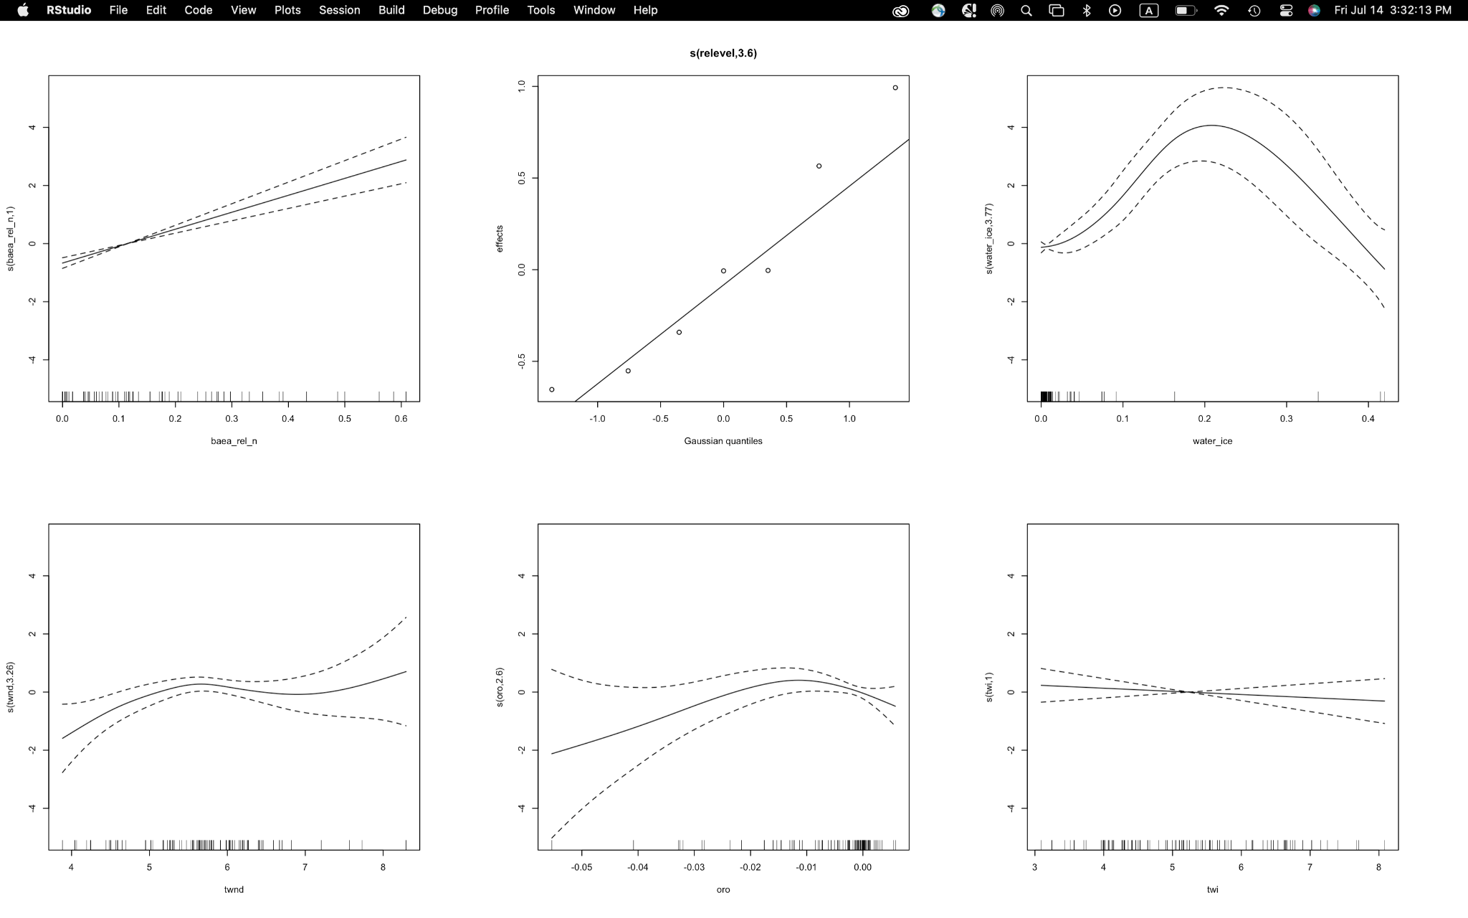
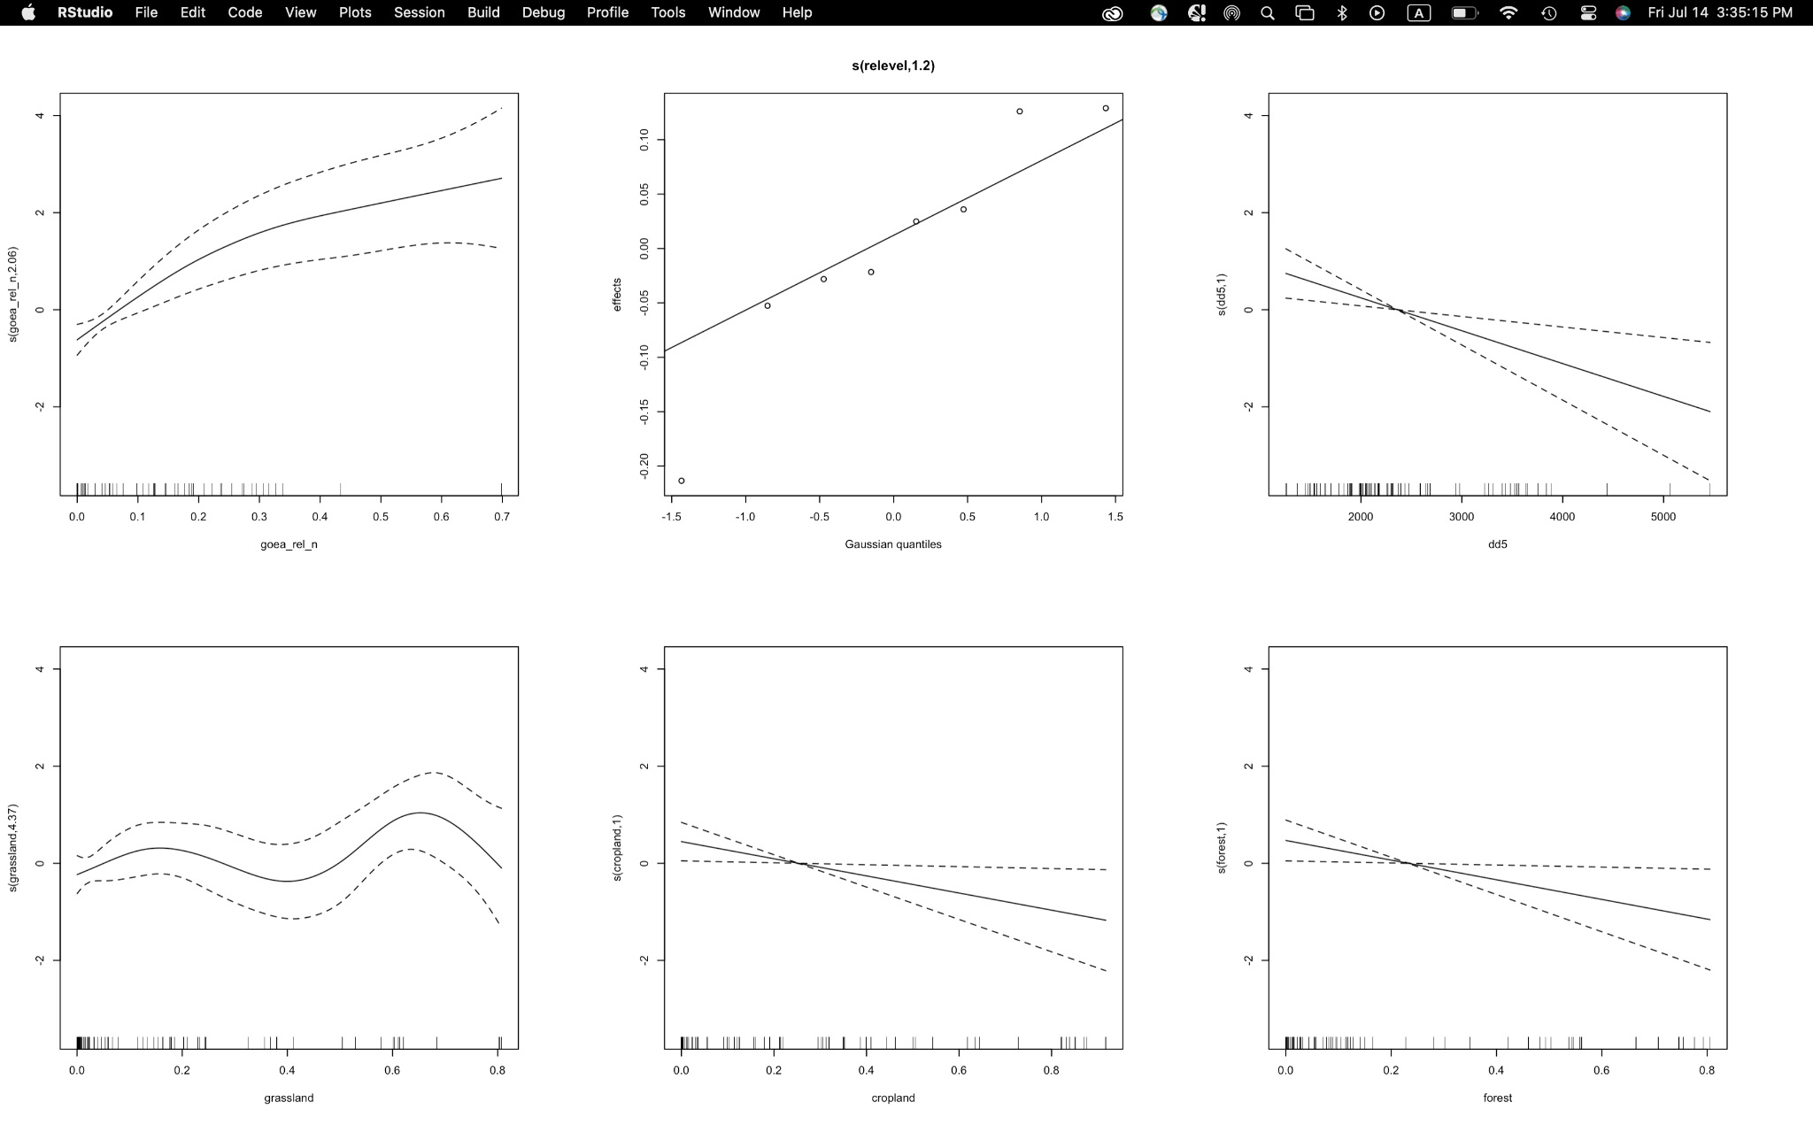
Models
Generalized additive mixed models
Tweedie distribution
Ecoregion as random effect
B.E.E.R
G.E.E.R
relative abundance
gaussian quantiles
water
relative abundance
Gaussian quantiles
Degree days over 5℃
Total wind speed
orographic uplift
Topographic wetness index
grassland
cropland
forest
Notes:
Built model sets based on biological hypotheses

Slide 11
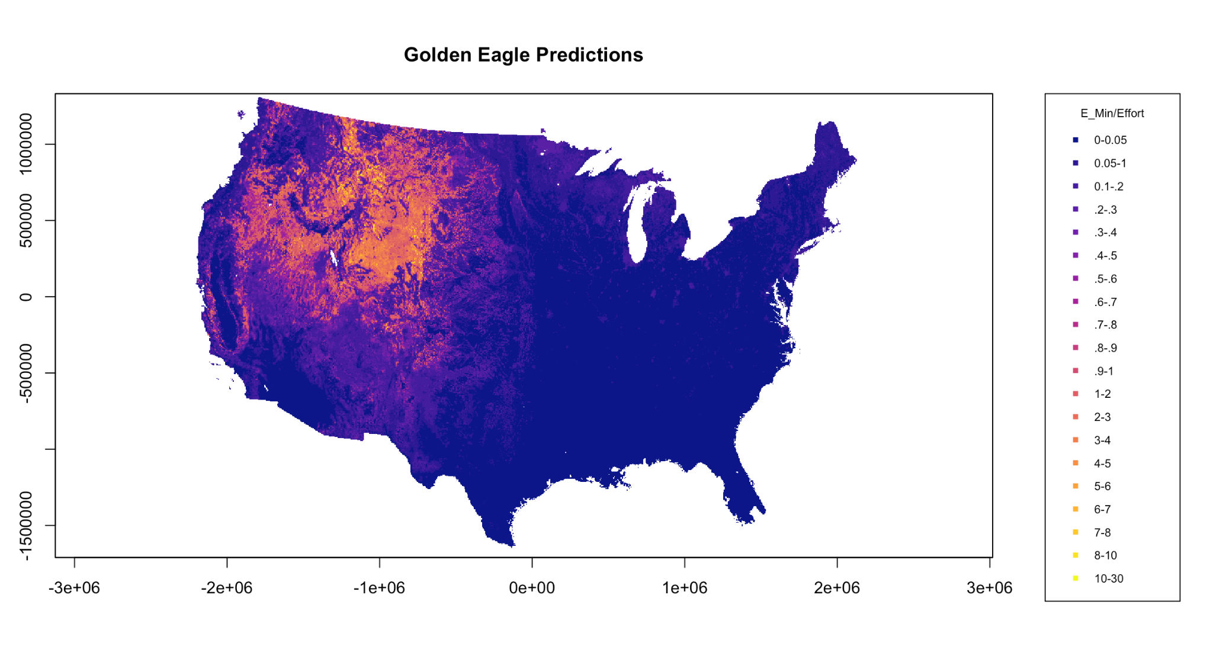
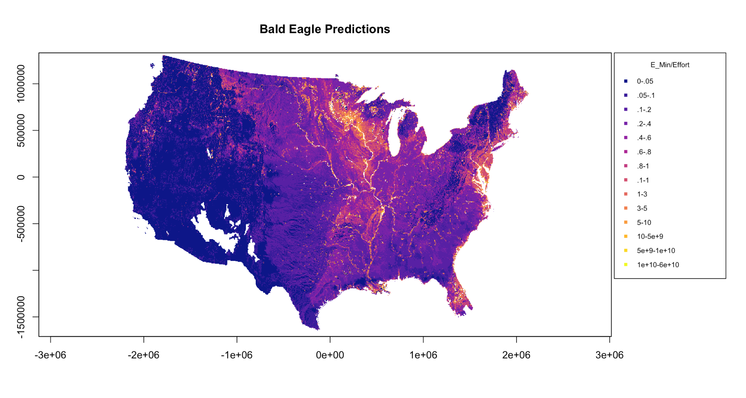
Species Distribution Models:
Notes:
Ran out of time for proper checks of prediction, but maps are consistent with known distribution of the species, barring some exclusion of balds in the north west

Slide 12
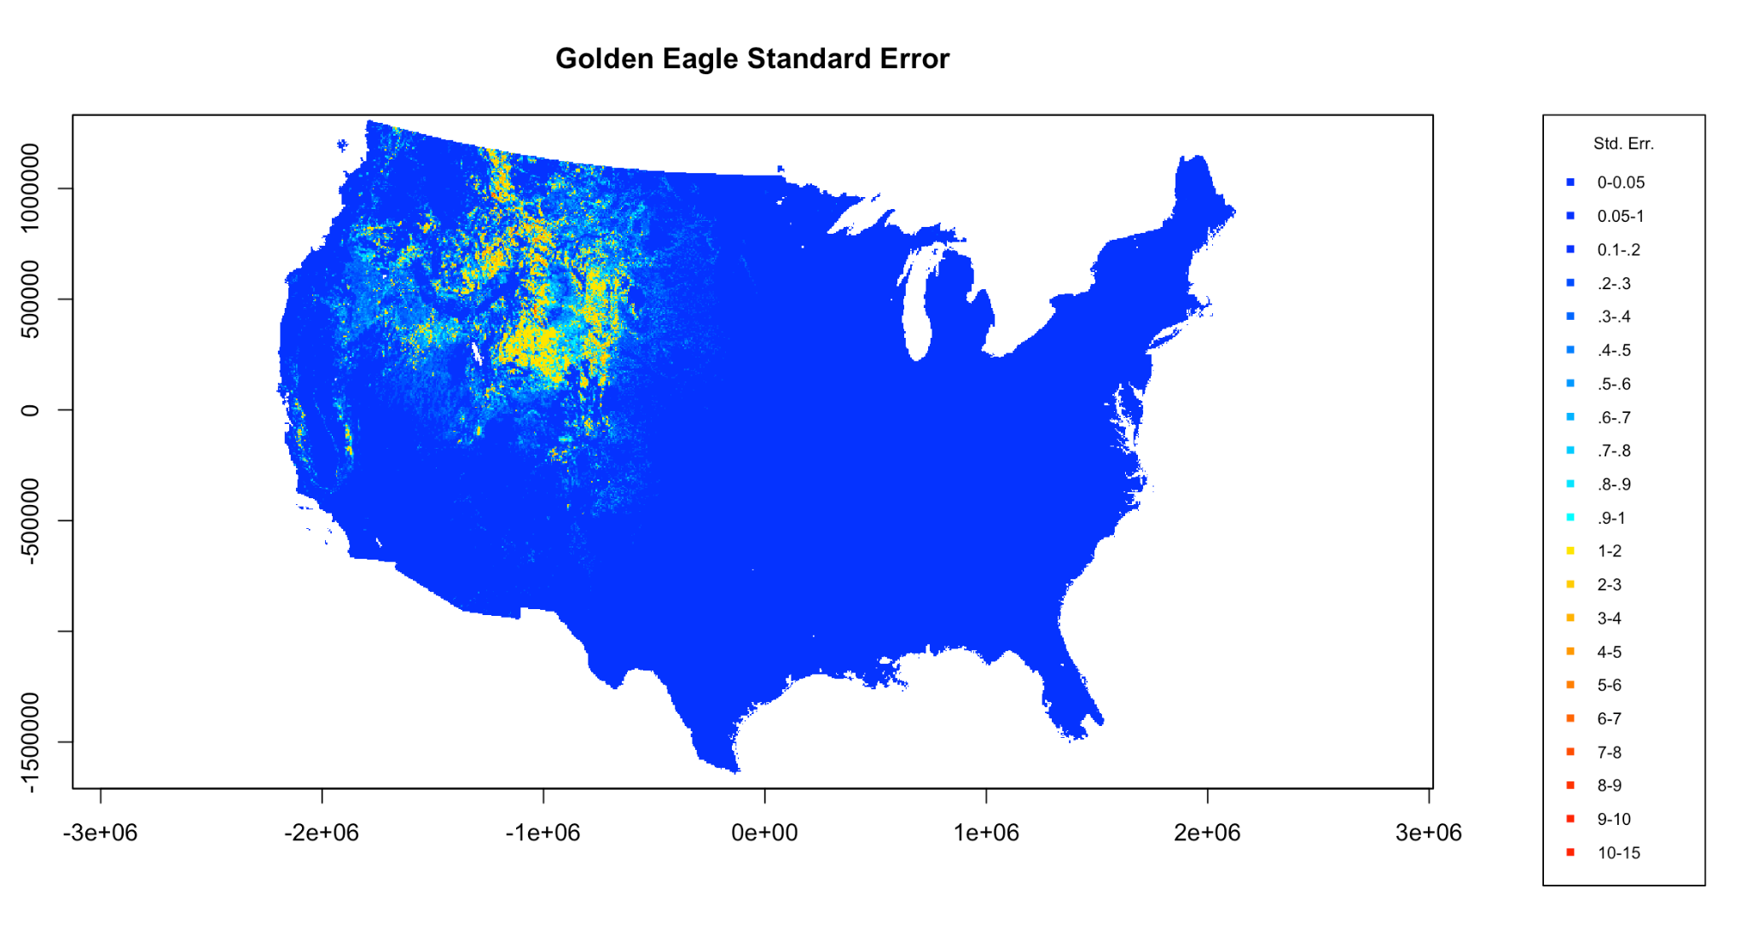
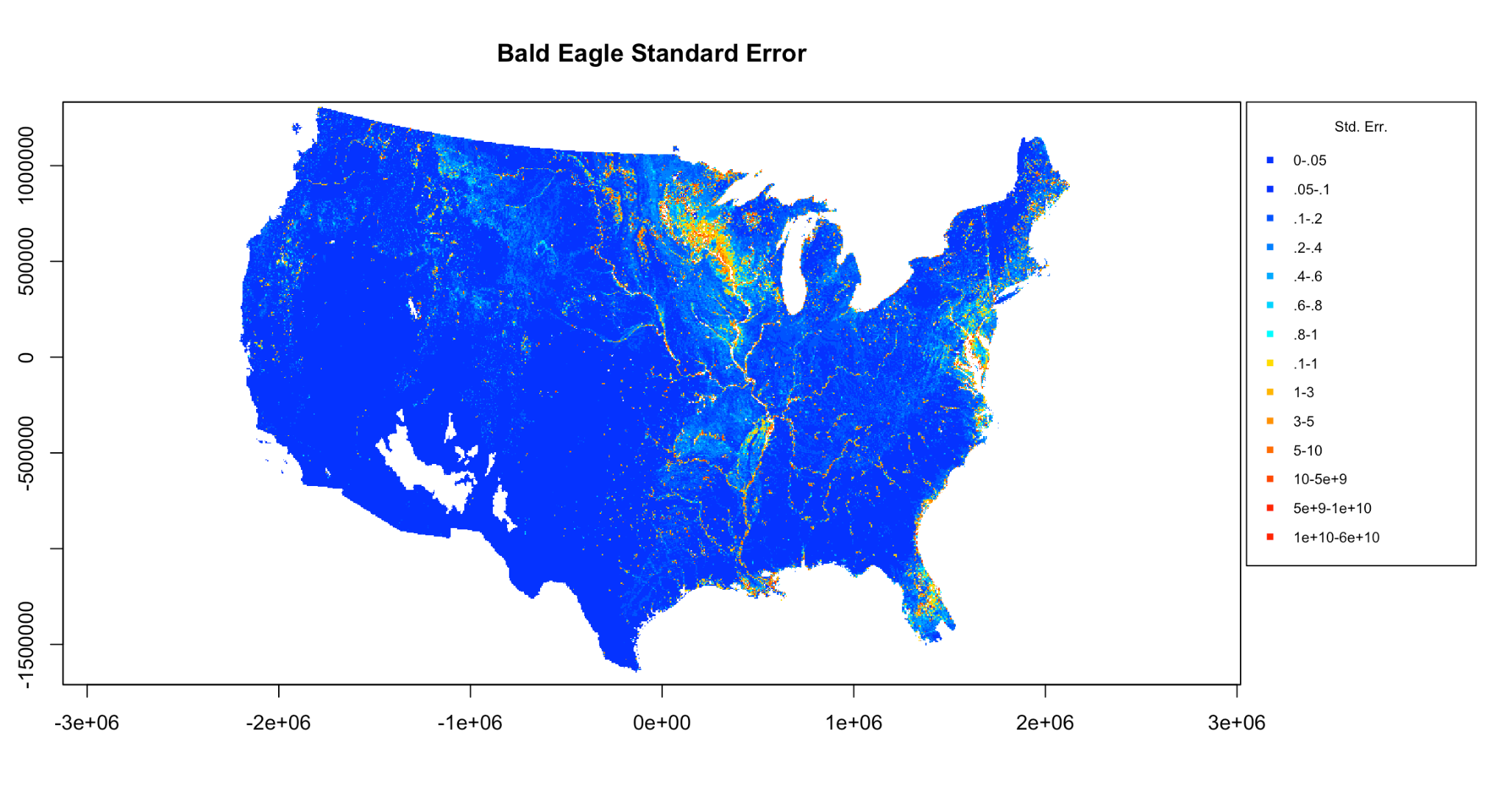
Uncertainty

Slide 13
Now what?
Limitations
Sparse data set
Timing of data collection
Bias towards wind facility locations
Level of uncertainty
No ability to incorporate time
Serves its purpose
Explore options
Demonstrate difficulties
Demonstrate weaknesses
Notes:
Maybe explore cross validation

Slide 14
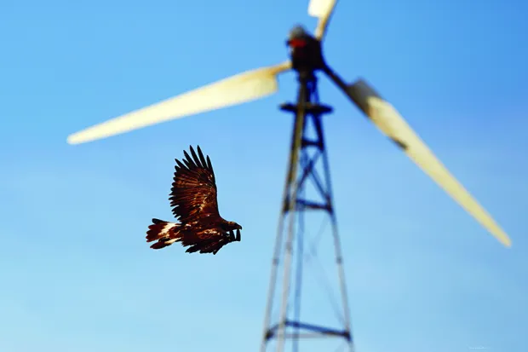
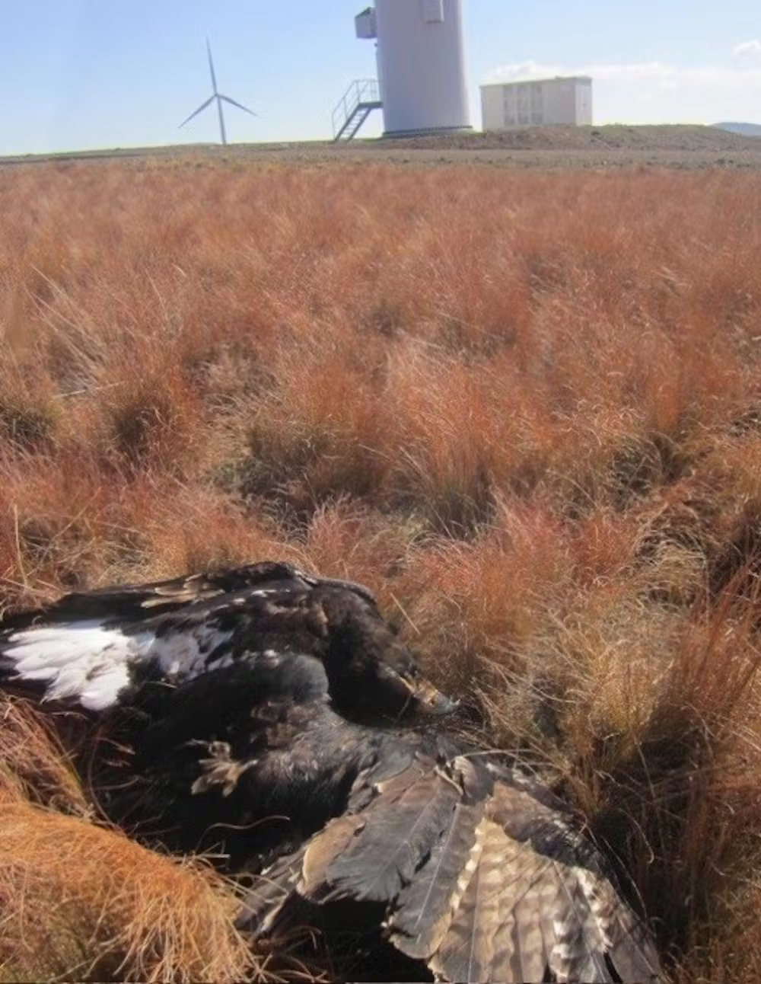
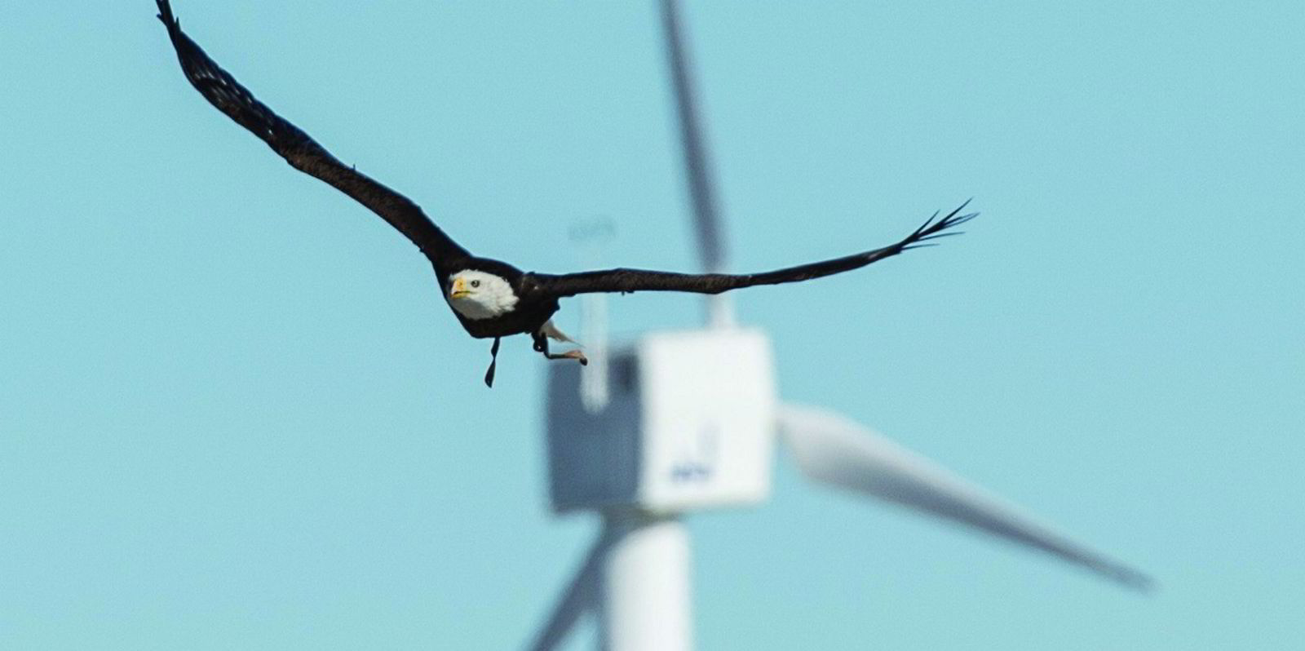
Thank you!
Credit: The Denver Post
Credit: The Conversation
Credit: Recharge News

